Slide 1
Source
Code Management
Sundar Rajan Renganathan

Slide 2
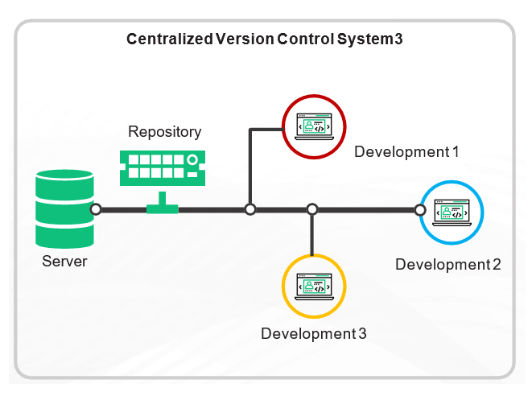
What is SCM?
Source code management is the practice of tracking modifications to source code. Keeping a running history of the changes made to a codebase helps programmers, developers and testers ensure that they’re always working with accurate and up-to-date code and helps resolve conflicts when merging code from multiple sources.
Source code management is important because multiple developers typically work in a shared codebase. And with each developer working on their respective feature, they could unknowingly make conflicting code changes — or one developer’s saved edits could overwrite the other developer’s changes.

Slide 3
Key Points
Record to maintain the changes made to the source code - Who? What? When?
All the changes to the source code, documentation, user manual, etc., should be tracked and versioned.
Versioning allows the change management to easily rollback to a previous working version, in case of an unsuccessful change.
Moreover, it enables the development and existence of multiple versions of the product that will allow the customers to take their own time to migrate.
Semantic Versioning (Major . Minor . Patch) is adopted widely.

Slide 4
Benefits & Role of SCM?
Benefits
Complete version history
More effective collaboration
Workflow automation
Better communication
Graphic displays of code history
Generated release notes
Code backup
Pipeline analytics
Role
It protects the source code
Developers can compare or restore earlier versions of code
It allows developers to work independently

Slide 5
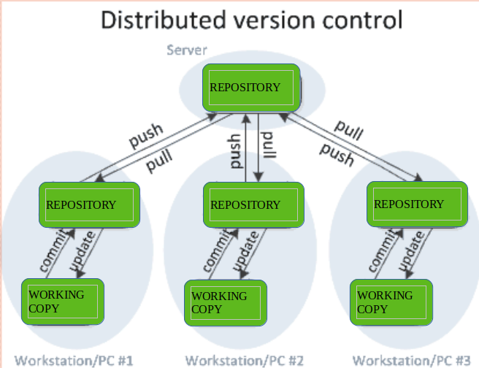
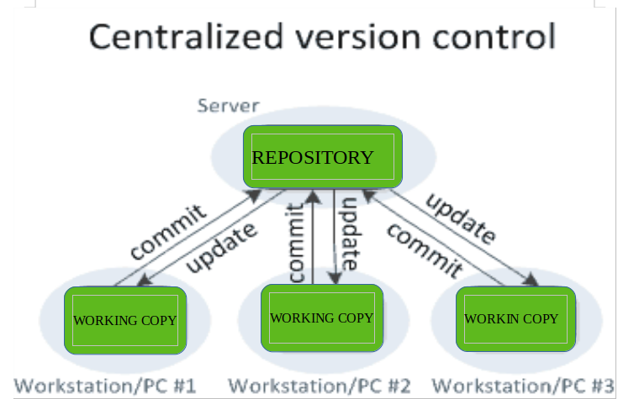
Types of SCM

Slide 6






SCM Tools

Slide 7
Terms
Repository
Check out
Commit
Check in
Conflict
Merge
Pull
Push
Commit Message
Pull Request
Branch
Trunk

Slide 8
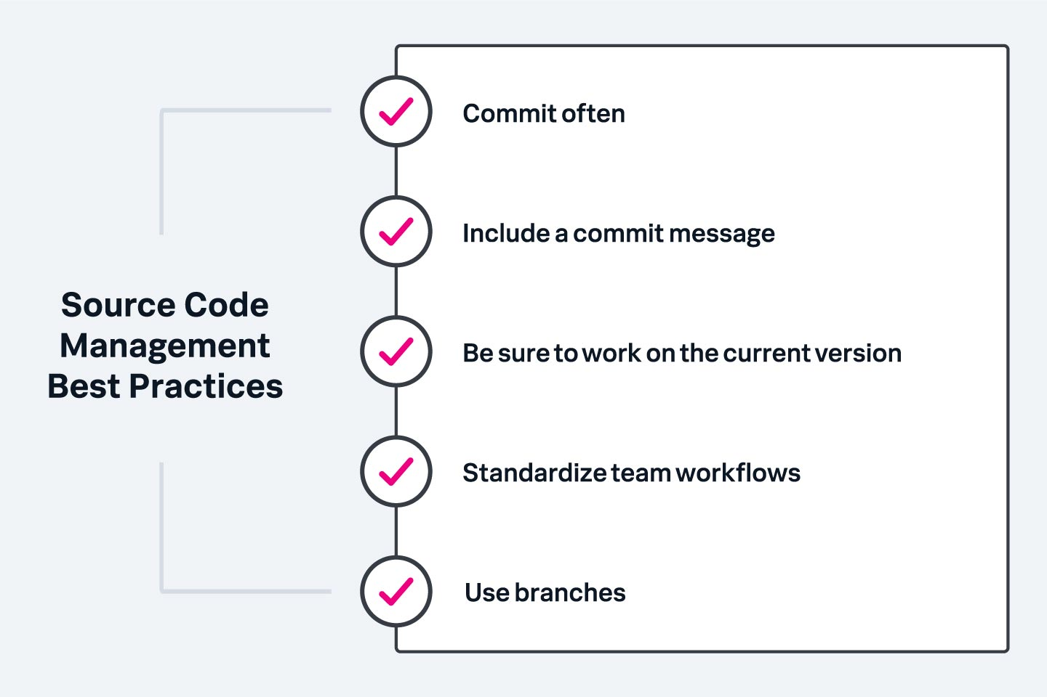
Best practices

Slide 9
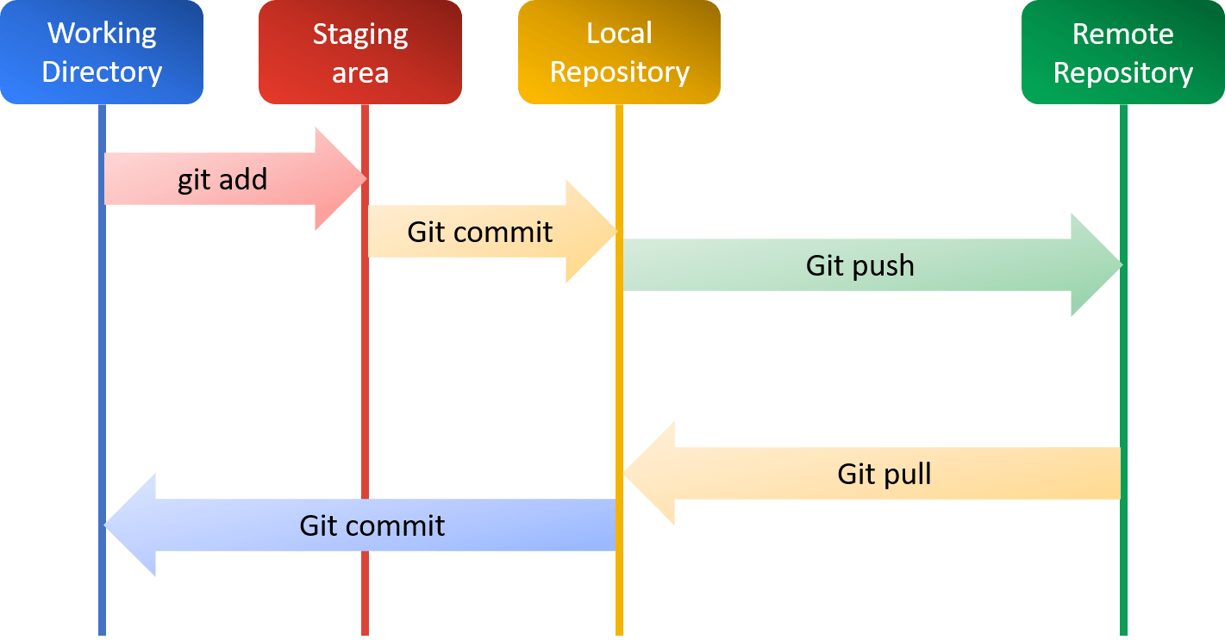
GIT

Slide 10
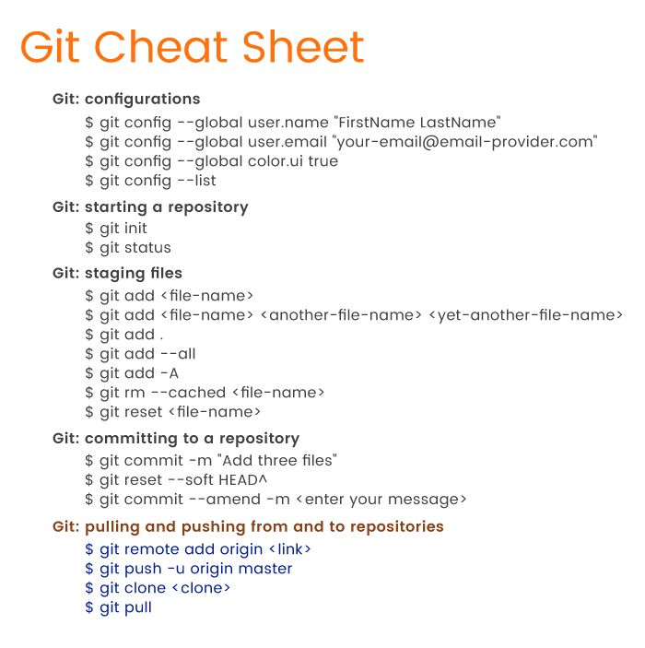
GIT Commands

